Slide 1
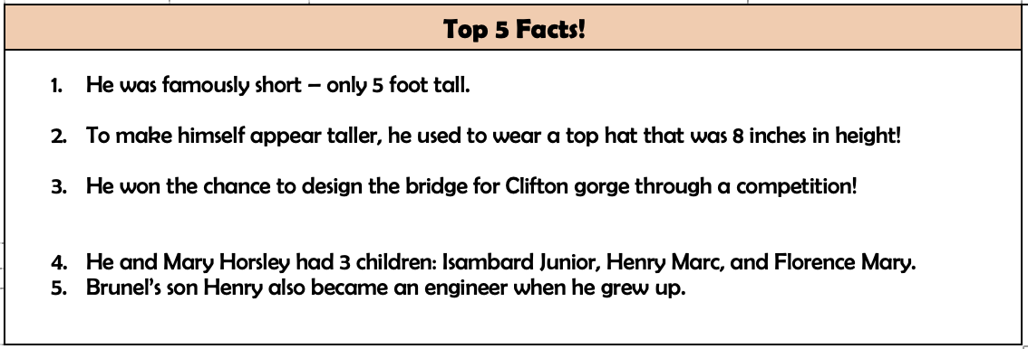
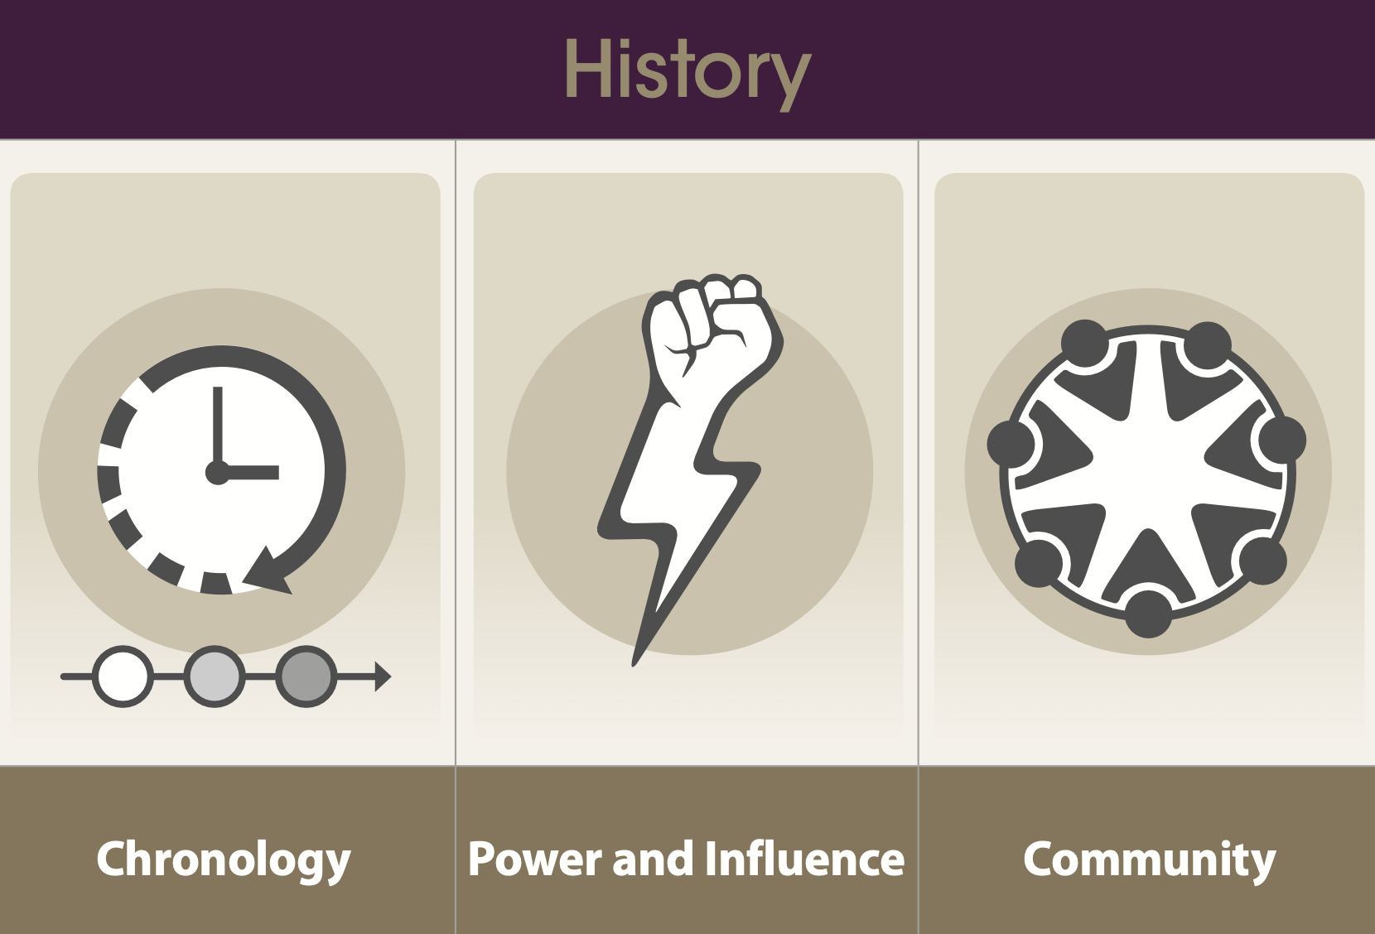
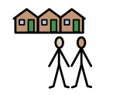
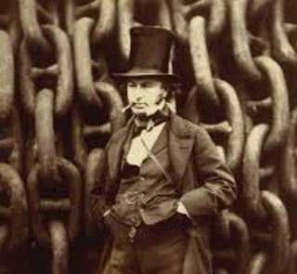
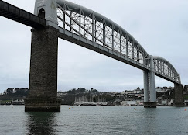
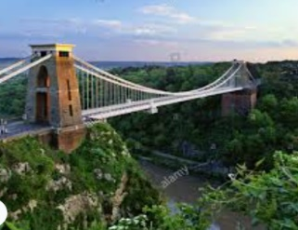
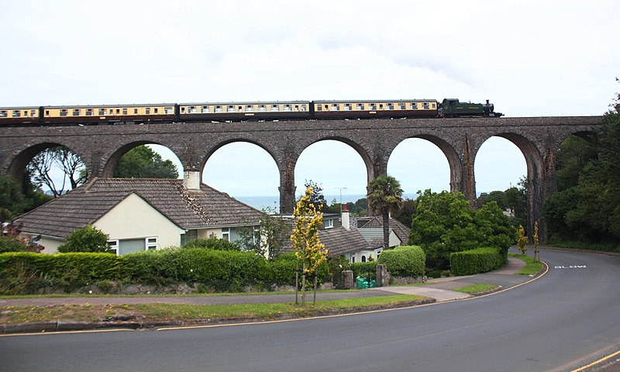
How did Brunel change the community?
HISTORY LEARNING organiser YEAR 2
Vocabulary
community | A group of people living in a particular area.
impact | To have a strong effect on.
century | A time period of 100 years.
design | To think up and plan something out.
engineer | A person who designs and builds products, machines, or structures.
transport | Different ways people use to move themselves and their goods from one place to another.
viaduct | A bridge for carrying a road or railroad over something
End of Enquiry Learning
I know who Brunel was and what he did. I know a change that has happened in my local area. I know what life was like in the community before the significant event. I know why an event was significant in my local area and the impact it had. I know how to place events on a timeline. I can ask a question about the past and suggest possible sources of primary and secondary evidence that might help me find answers. I can explain what an account is and why these might be different. I can use a range of sources to tell others about the past.
Isambard Kingdom Brunel Timeline
1806: He is born in Portsmouth, England, UK.
1808: Brunel’s family move to London.
1825: Began work on the Thames Tunnel.
1833: Becomes Chief Engineer of the Great Western Railway.
1838: His SS Great Western travels from Liverpool to New York in 13 days.
1854: Opens Paddington Station.
1859: Brunel dies of a stroke in London, UK.
1864: The Clifton Suspension Bridge is finished.

