Slide 1
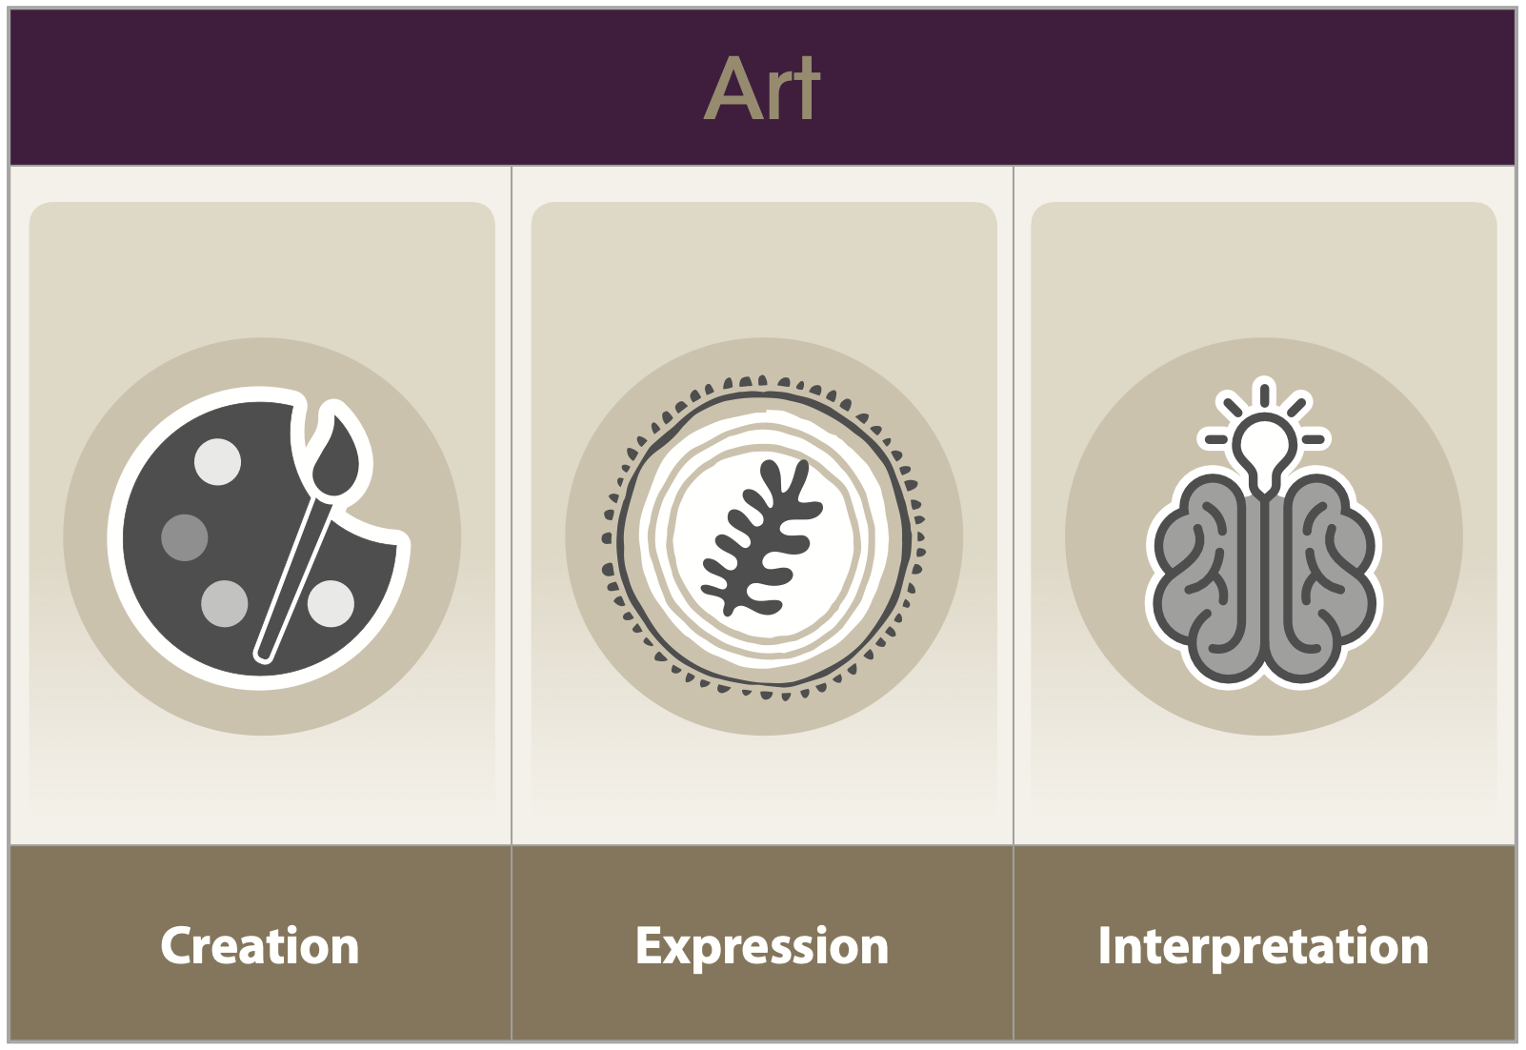
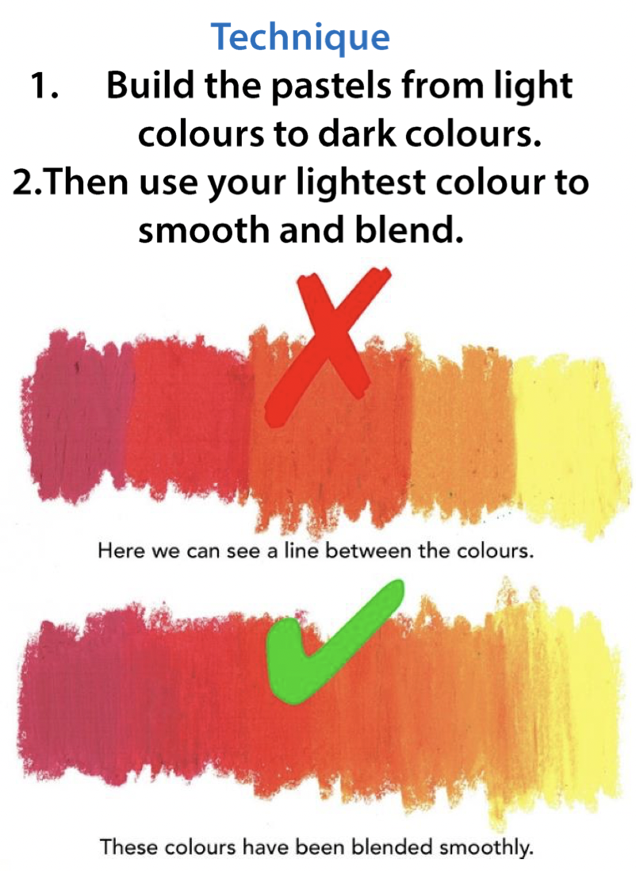
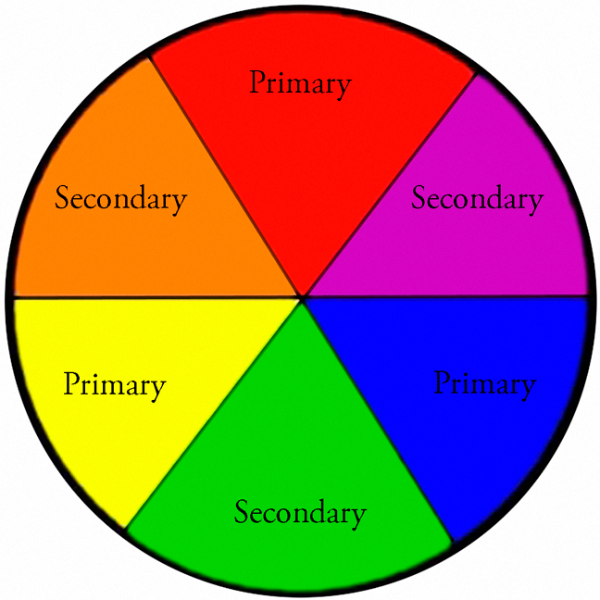
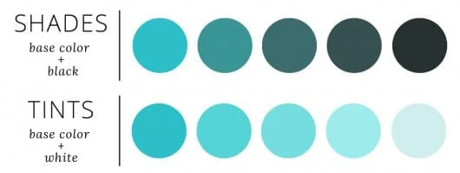
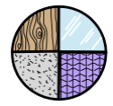
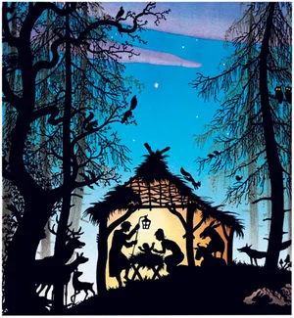
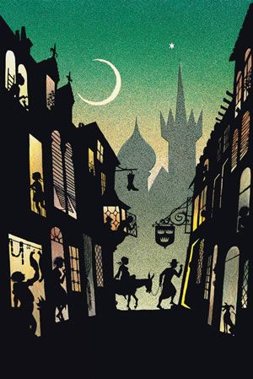
How can I use silhouettes to create a beautiful Christmas card?
ART LEARNING organiser YEAR 2
Vocabulary
Effect | The impact something has.
Media | The materials used to make a work of art.
Primary | Colours that cannot be made by mixing other colours.
Secondary | The colours we have when mixing two primary colours together.
Tone | The lightness or darkness of colours used.
Texture | How something feels when it is touched.
Perspective | The representation of how an image is seen by the eye.
Refine | To make changes to improve or explain
End of Enquiry Learning
I know how to make use a combination of marks to shade. I know what secondary colours are. I know how to mix paint to form tones. I know how different brushes and sponges can be used to create. I can show the effect of light on an object. I can use a combination of media to create an outcome. I can show the development of my ideas. I can create images both real and imagined.
Artist: Jan Pieńkowski
Lifespan: 1936 – 2022
Nationality: Polish

