Slide 1
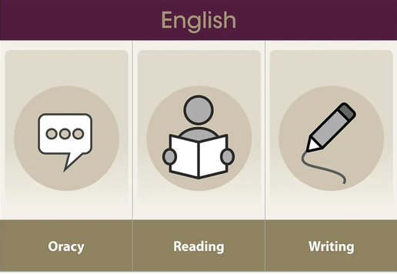
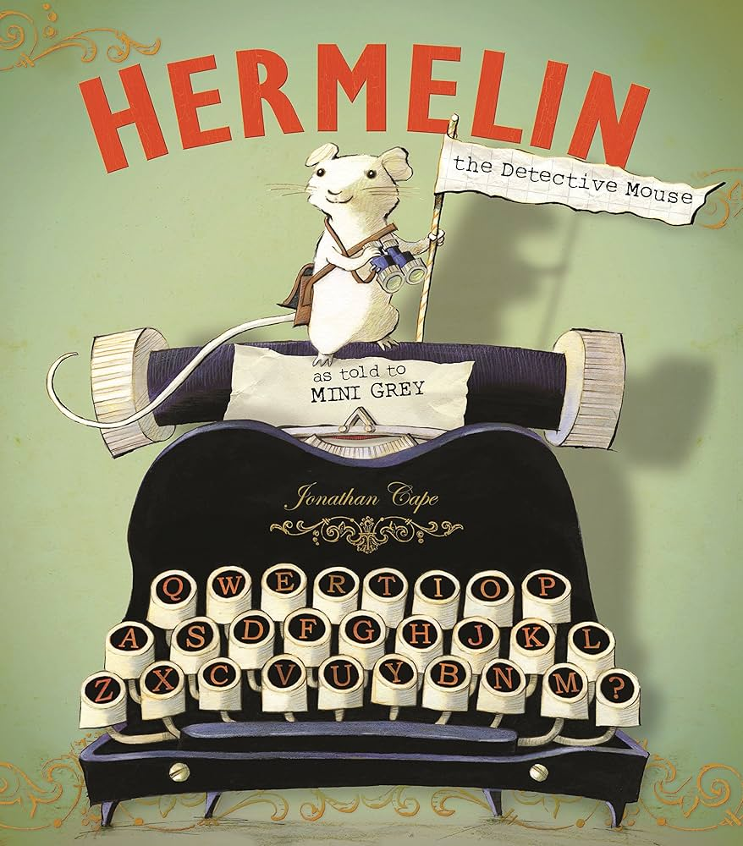
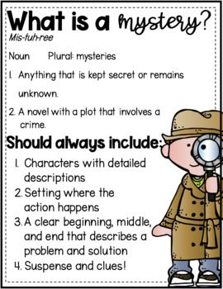
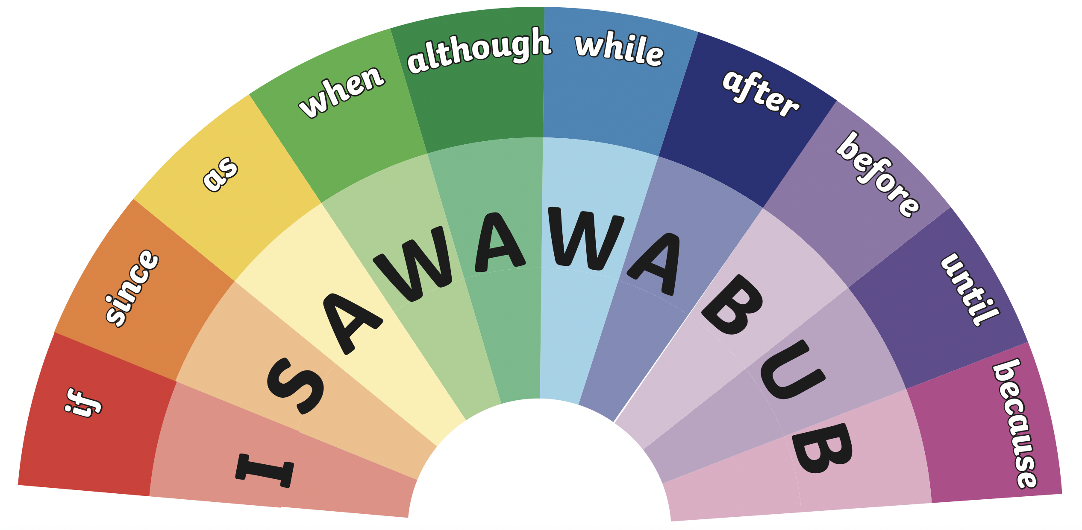



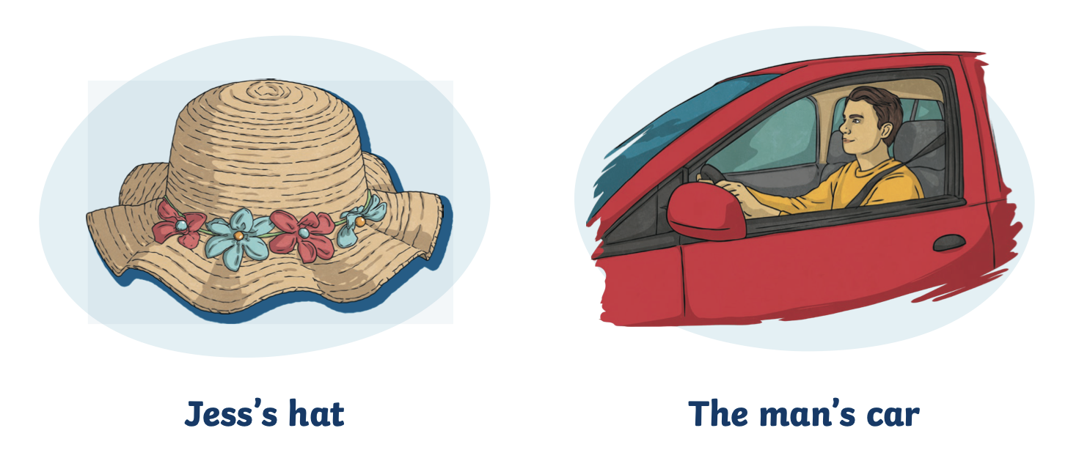


How can I create a mystery story that keeps the reader guessing?
Writing LEARNING organiser YEAR 2
Vocabulary
Noun | The name of a person, place or thing.
Verb | A word to describe action or being (sang, slept, ran, looked).
Adjective | A word to describe the noun (large, tall, small, short, yellow).
Simple noun phrase | A word that helps describe the noun (small cat, large house).
Onomatopoeia | A word that names a sound, but also sounds like that sound (zoom, crack, splat, pop).
Apostrophe | A punctuation mark (') used to indicate either possession (Harry 's book ) or the missing letters (can ’t , he 's ;).
Adverb | A word used to describe the verb (slowly, quickly, angrily).
Subordinating conjunction | The word/words that is used to join a subordinating clause to another clause or sentence (when, because, that, if).
End of Enquiry Learning
I will use simple adverbs I will use simple noun phrases I will use apostrophes for contraction. I will use apostrophes for possession. I will use time connectives (one day, after, as soon as, by next morning, soon, the, until). I will use subordinate conjunctions (when, if, that, because). I will use coordinating conjunctions (and, or, but, so).…”

